Slide 1
vehicle detection
- Abdullah Hafiz
- Khaled Binasker
- Abdulmalik Faden
- Taher Mutanbak
Miniproject in Week6

Slide 2
Project overview
Our project aims to train a model to detect vehicles in the pictures and classify them

Slide 3
Project steps
Choose the idea
Choose a Model
Sample from result
Data collection
Model Evaluation

Slide 4
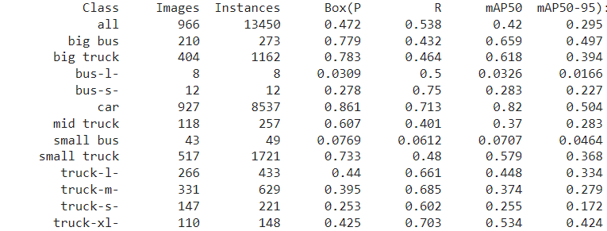
Dataset
The dataset, sourced from roboflow,

Slide 5
Coding steps
Import libraries
Visualization
Load data
Fetching YOLOv8
Show Sample
Evaluate Model
Training Model
Test Model

Slide 6
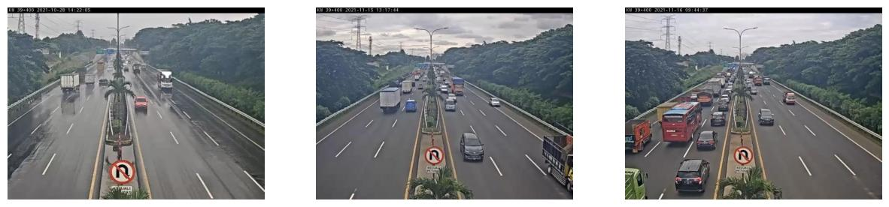
Image Visualization

Slide 7
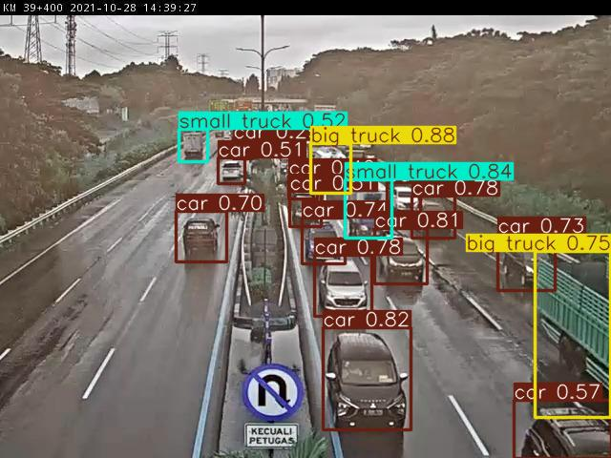
Show Sample from Test Model

Slide 8
Thank You

